Slide 1
Project 5: Image colorization
Group 10:
Qianli Zhu, Hongyu Li, Yuexuan Huang, Fan Yang, Jia Zheng

Slide 2
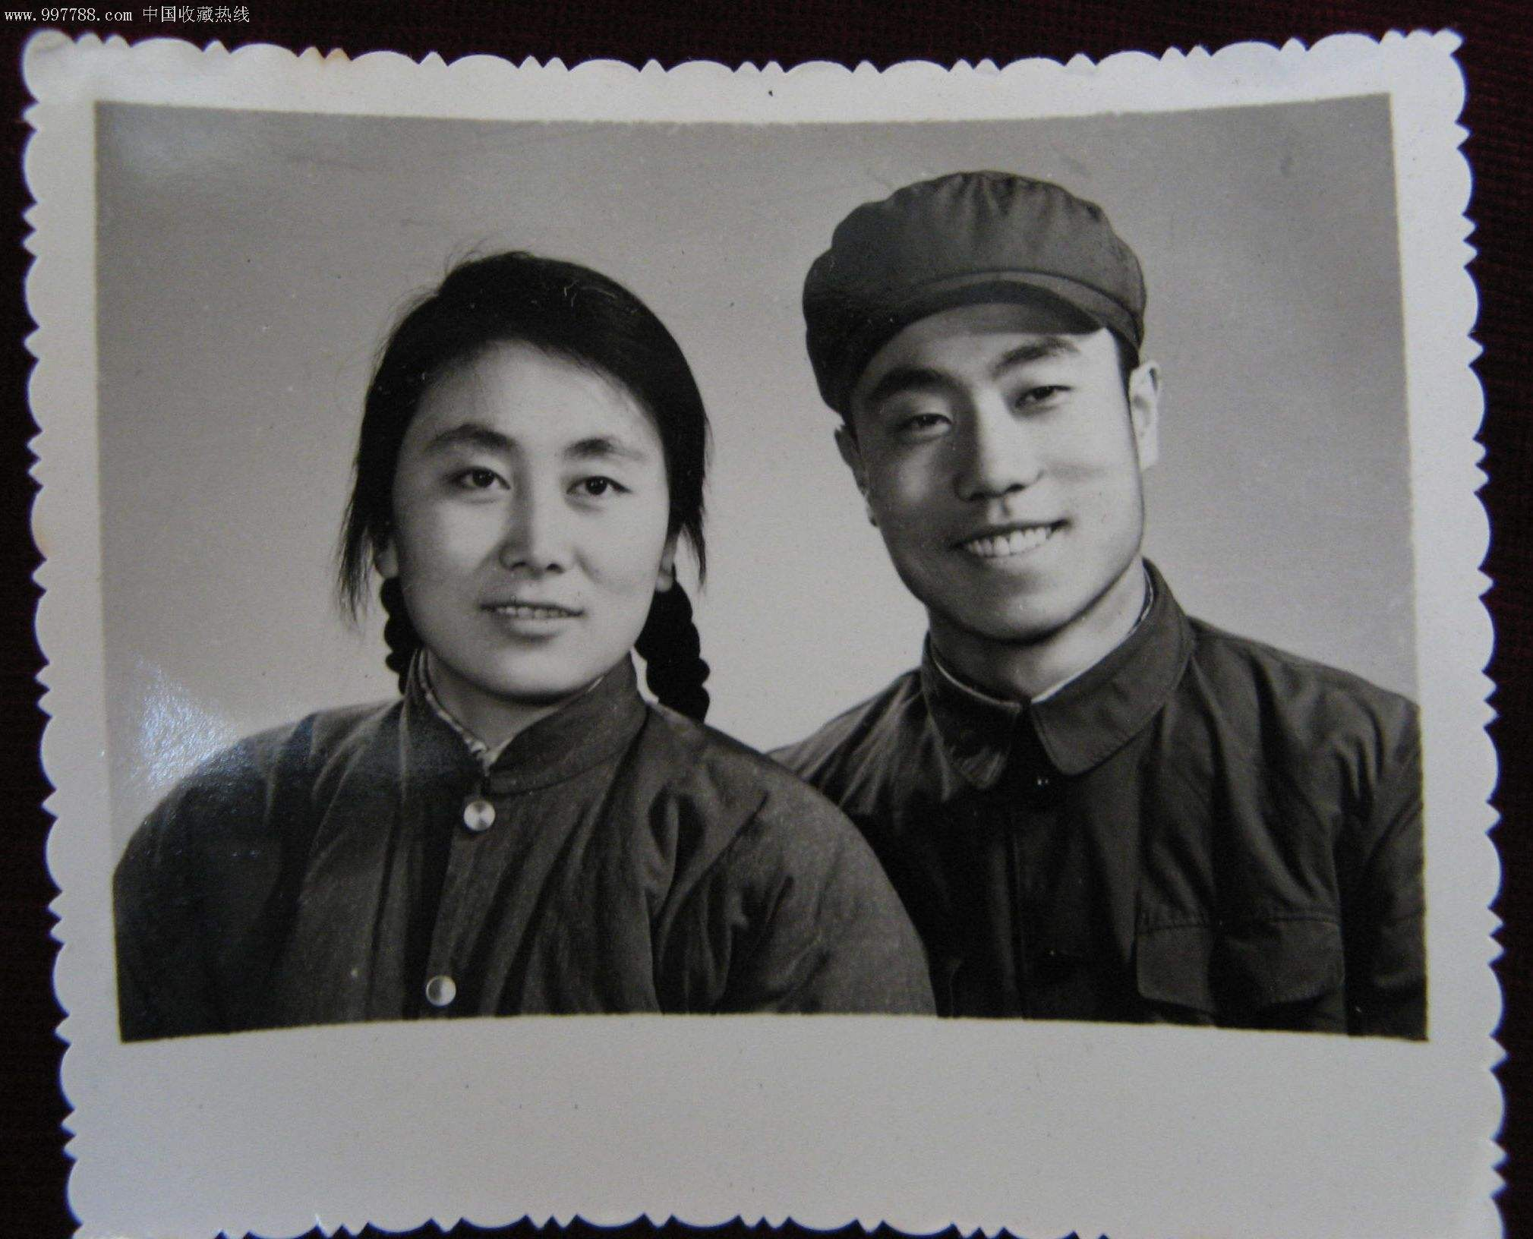
Motivation
Photo always records a memorable moment for us. Lots of valuable photos which shot long time ago are black and white.
So, is it possible if we could help those black and white images get their colors ?
Further more, is that possible if we could colorize a black white movie ?

Slide 3
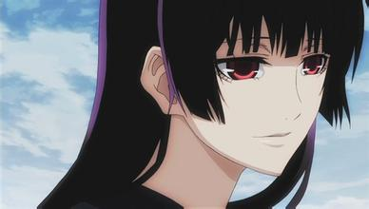
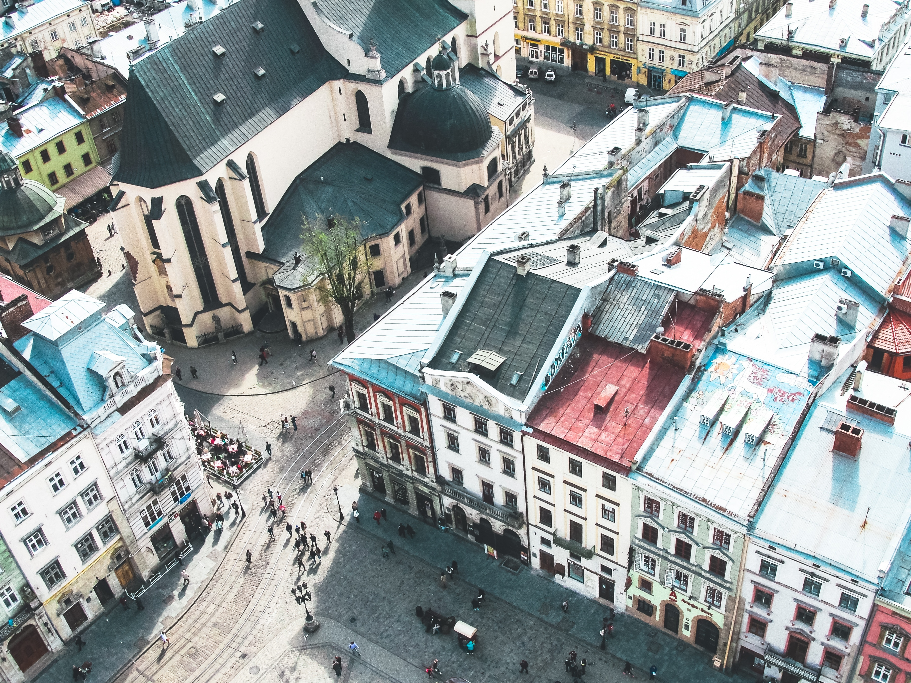
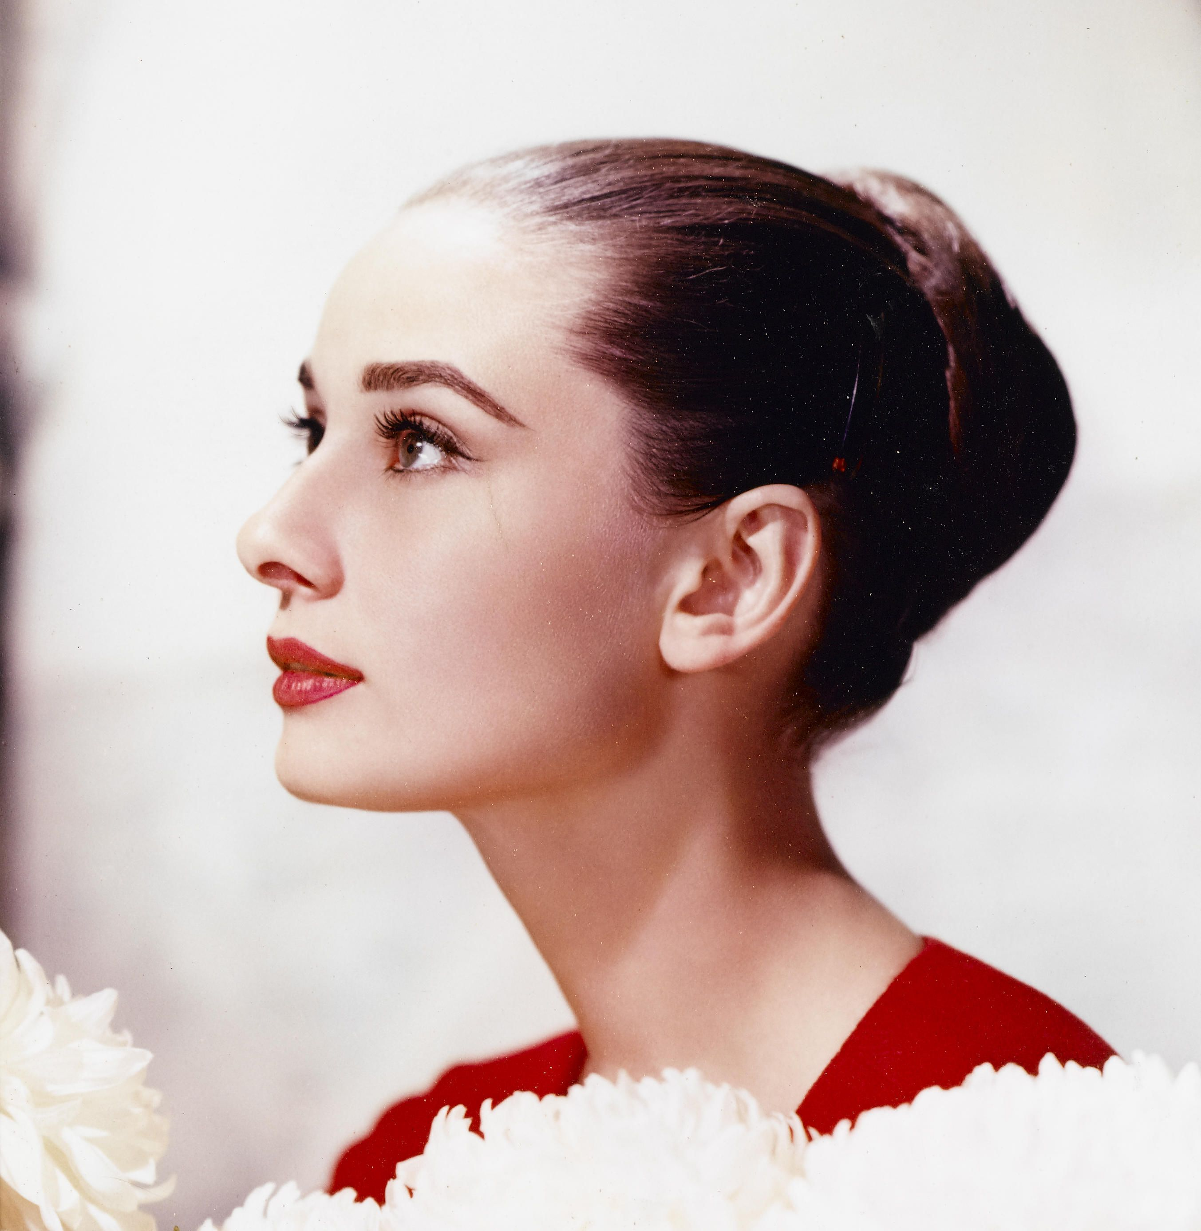
Data set
We collect several types of images, each of them will be resized as 256*256:
CARTOON
ARCHITECTURE
HUMAN

Slide 4
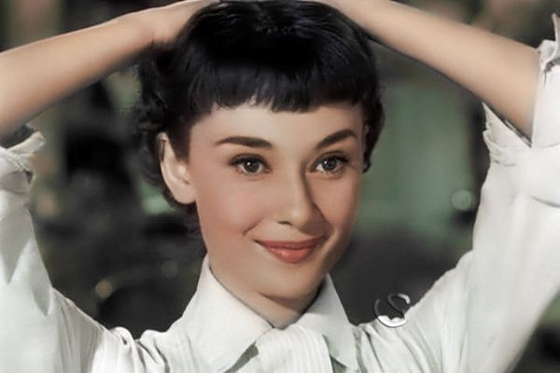
Algorithm
Training
TRAINING IMAGE
CORLOR SPACE
(K-MEANS)
EXTRACT FEATURES FROM ALL PIXELS
TRAIN MODEL

Slide 5
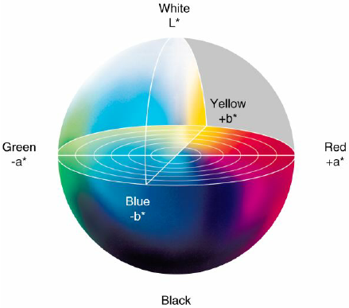
Color space
We use L*a*b color space in this project, which describes mathematically all perceivable colors in the three dimensions:
L - lightness
a - green–red
b - blue–yellow
In this project, we mainly focus on studying the relationship between L and other features and a,b
Since L will be always fixed no matter it’s a B&W image or colorful image

Slide 6
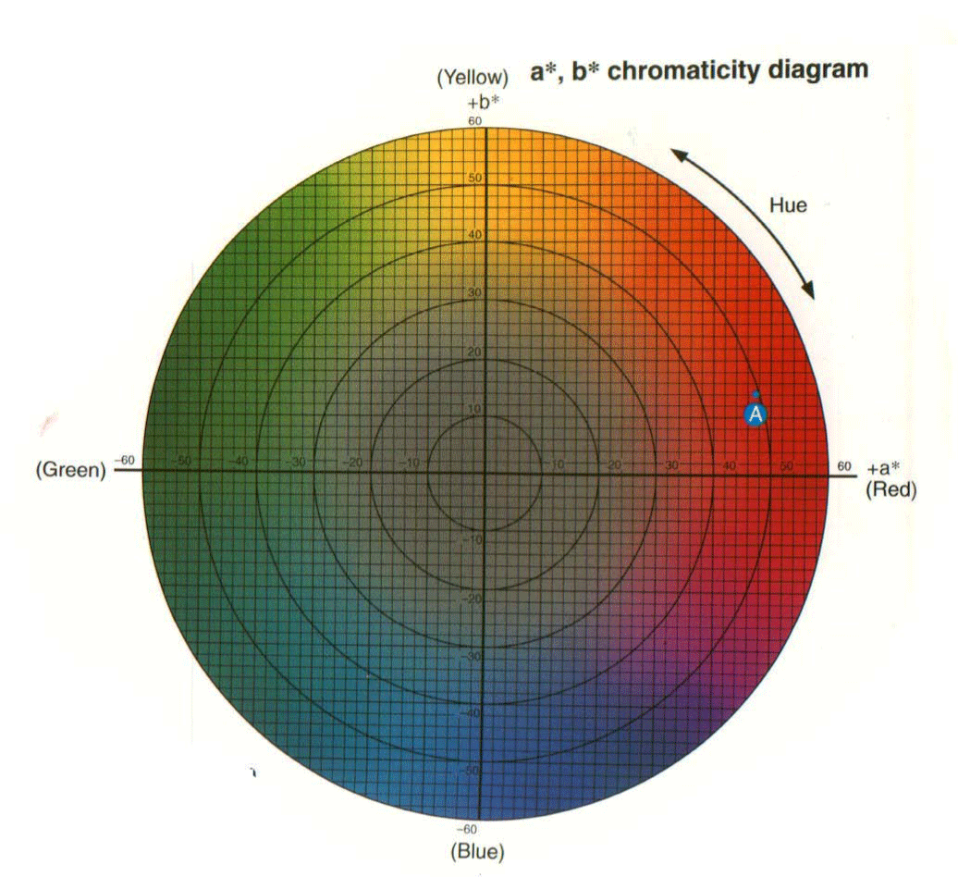
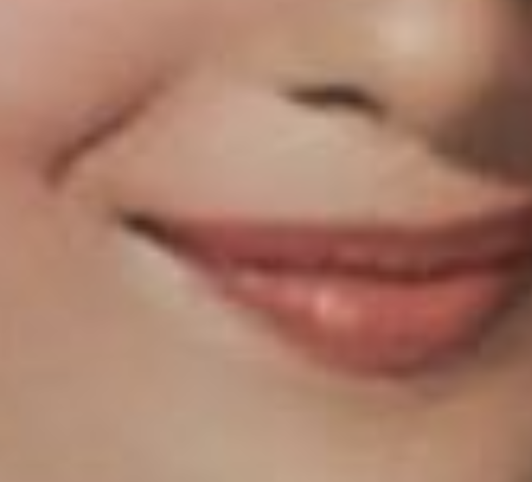




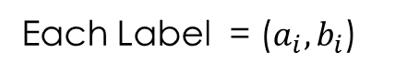
Conversion/quantization (K-means)
Each Label = ($a_{i},b_{i}$)
Input same type images to do K-means
Reduce the color space via k-means to a manageable subset of colors – typically ranging between 8 and 32 – and store this color mapping for use by the final output step.
Give each cluster a label, and get a color map, which has K colors with label.
Then, it turns our colorizing problem to a classification problem as Labels(a, b) ~ Features

Slide 7
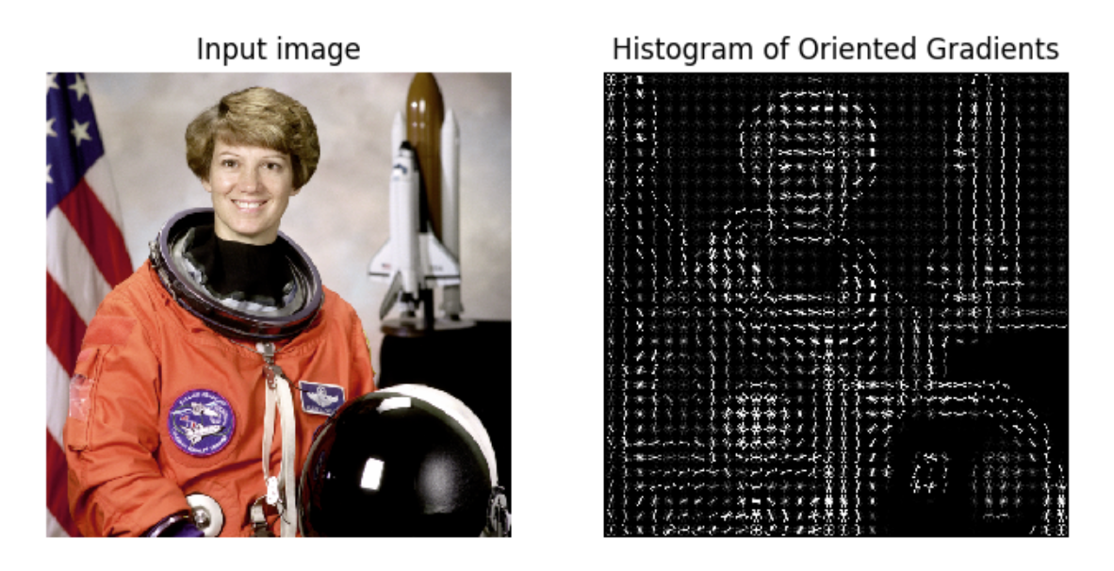
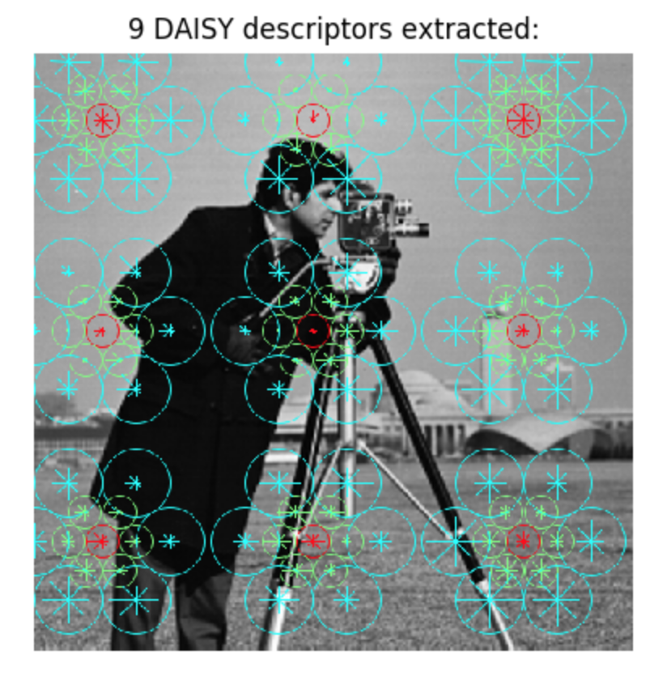
FEATURE EXTRACTION
We extract the layer of L, HOG and Daisy as our features, and use those features as our predictors to classify the labels in color map

Slide 8
model
Model we tried:
CNN
SVM
XGBOOST
GBM
We use 10 256*256 same type images for each model, which generates 10*256*256 observations for us,
Further, each model has 5 feature predictors, 1 L Layers, 1 HOG, 3 Daisy

Slide 9

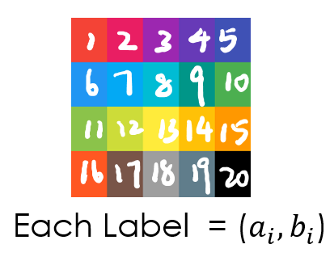
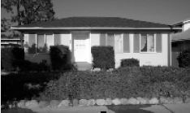
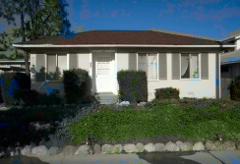
COLORIZATION
MODEL
a,b Layer
INPUT IMAGE
EXTRACT FEATURES AT EACH PIXEL
Input features
Output a label
FEATURE EXTRACTION
COLORIZED OUTPUT

Slide 10
Evaluation
MODEL/Type | Cartoon | Architecture | Human
SVM | 15.74% | Poor | Poor
XGBOOST | 42% | 26.25% | Poor
GBM | 52.77% | 48.63% | 32.67%
*We use 0-1 loss to evaluate our model

Slide 11
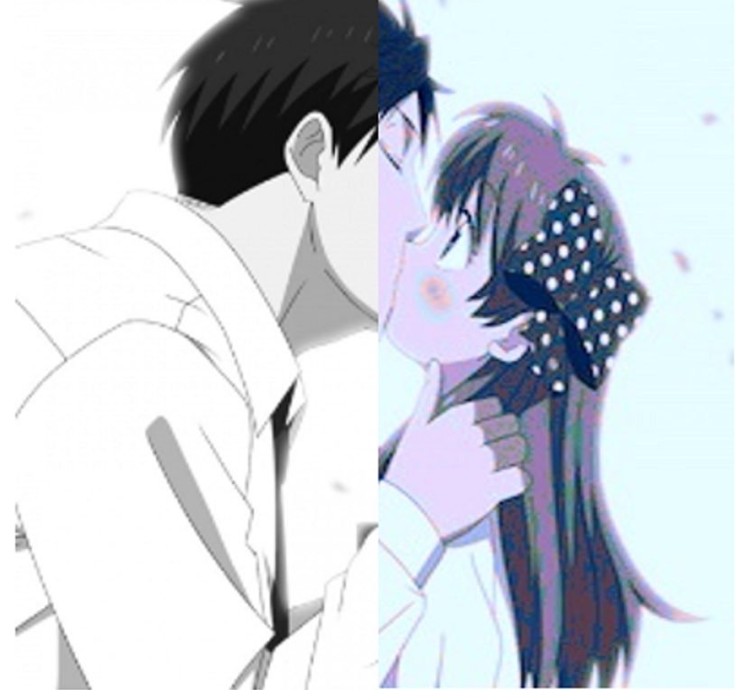
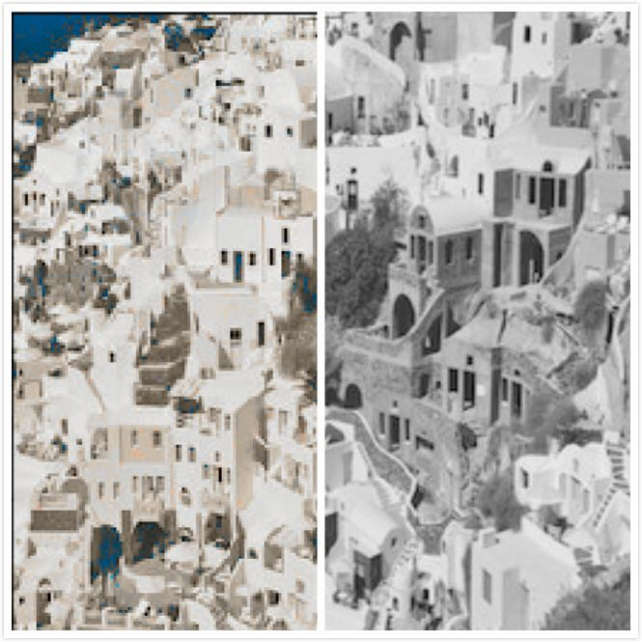
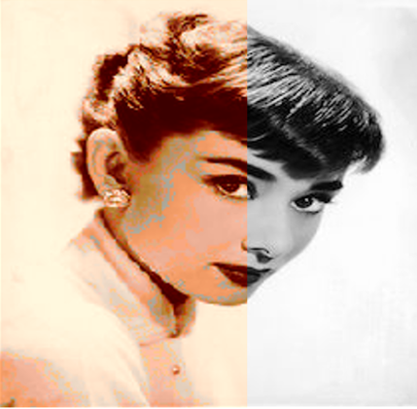
EVALUATION
Colorized / Input(B&W)
Colorized / Input(B&W)
Colorized / Input(B&W)

Slide 12
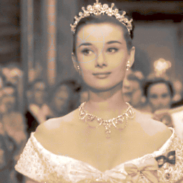
IMPROVEMENTS
Generalization:
Currently we trained three models for each type of images
Optimize the color map, since it limits the number of colors would be applied on colorization
Colorization for Human Portrait:
We find that human is more difficult to colorize, since the portraits has much more complicated structure of features
Accuracy:
We need further advance our models, and improve the accuracy

Slide 13
bibliography
Sousa, Austin, et al. “Automatic Colorization of Grayscale Images.” pp. 1–5., cs229.stanford.edu/proj2013/KabirzadehSousaBlaes-AutomaticColorizationOfGrayscaleImages.pdf.
Deshpande, Aditya, et al. “Learning Large-Scale Automatic Image Colorization.”Http://Vision.cs.illinois.edu/Projects/Lscolor/, 2015, www.bing.com/cr?IG=6B02F6641D5E4031BC11DA38D3088C94&CID=251B462EF8D16B7116D44DF2F97E6A82&rd=1&h=dTjkRAib9tO5pMcu443bwSJf5e5e-7HRyxu8rBnroDc&v=1&r=https%3a%2f%2fwww.cv-foundation.org%2fopenaccess%2fcontent_iccv_2015%2fpapers%2fDeshpande_Learning_Large-Scale_Automatic_ICCV_2015_paper.pdf&p=DevEx.LB.1,5077.1.
Iizuka, Satoshi, et al. “Let There Be Color!: Joint End-to-End Learning of Global and Local Image Priors for Automatic Image Colorization with Simultaneous Classification.” Let There Be Color!: Joint End-to-End Learning of Global and Local Image Priors for Automatic Image Colorization with Simultaneous Classification, 2016, hi.cs.waseda.ac.jp/~iizuka/projects/colorization/en/.
All the data images are from open free source

Slide 14
Thank you
Q&A

